Slide 1




Slide 2
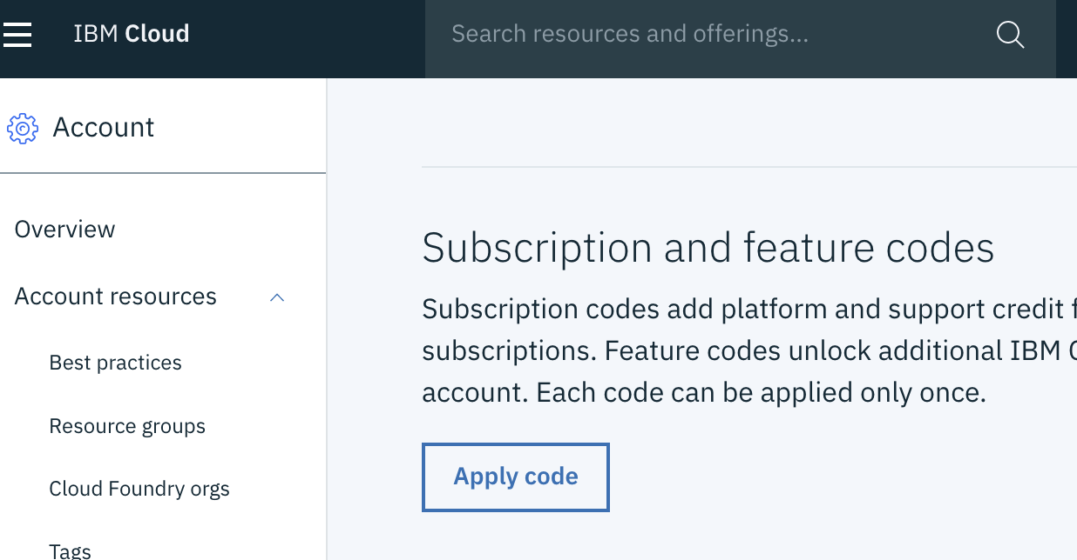
You should get an email that includes a "Feature Code".
-Using "cloud.ibm.com" navigate to:
=====>MANAGE/ACCOUNT,
======> ACCOUNT SETTINGS
=====> Locate the FEATURE/SUBSCRIPTION (PROMO CODES) section & click "APPLY CODES"
Feature Codes
Subscription
2
Notes:
Each grouping will execute the following:

Slide 3
Your IBM Cloud account is a valuable resource. Many successful organizations create a Center of Excellence(COE) which includes or is closely associated with an IBM Cloud account Administrator. The COE will set policy to determine which projects get access and consumption guidelines. The administrator is key in actualizing and enforcing those policies.
When assigning an administrator consider the following 4 functions.
Access: The Administrator can invite users and assign access roles as well as create resource groupings.
Create and remove services: An Administrator will be able to provision and delete instances and data.
Notifications and Billing : IBM Cloud will send notifications on maintenance and cloud events that may have service impacts. In many cases the administrator is responsible for monitoring this communication as well as monitoring usage/billing.
Ticketing: Your administrator may be compelled from time to time to submit support tickets relating to the overall account. These tickets may range from billing/consumption anomalies to SLA infraction requests.
Assigning Roles Administrator
3
Notes:
admin can provision and delete instances and data as well as assign other user access including making others admins.

Slide 4




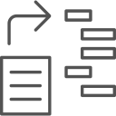


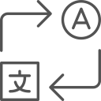

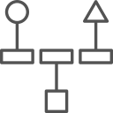


Watson Products
Watson Accelerators
Watson Expert Services
Watson Assistant
Voice of the Customer
Design
Watson Discovery
Tone Analyzer
Compare & Comply
Natural Language Understanding
Customer Care
Learn
Personality Insights
Plan
Expert Assist
Knowledge Studio
Build
Visual Recognition
Compliance Assist
Language Translator
Deploy
Speech-to-Text
Natural Language Classifier
On Demand Consulting
Text-to-Speech
+ Custom Engagements
Watson Explorer
4
Notes:
AI lifecycle automation
Drive productivity within a unified, fully governed platform
Pre-built enterprise apps
Speed time-to-value with less skills required
Proven, prescriptive, trusted
Partner with the leader in applied enterprise AI
Can be leveraged as endpoints, from the IBM cloud, from behind your firewall or even deployed within your firewall or in another providers cloud.

